Slide 1





AI-Powered Resume Screening and Ranking System
Team : Chauhan Arpit Nareshji , arpitchauhan075@gmail.com
Guide: Saomya Chaudhri
Notes:
Slides: Prepare a short slide deck (10-12 slides) summarizing the project objectives, methodology, and key results.

Slide 2
System Architecture
Components:
Text Extraction from PDFs (PyPDF2)
Feature Extraction (TF-IDF)
Similarity Calculation (Cosine Similarity)
Ranking Resumes
Streamlit User Interface

Slide 3
Methodology
Step 1: Extract text from resumes using PyPDF2.
Step 2: Convert text to numerical vectors using TF-IDF.
Step 3: Compare resumes with job description using Cosine Similarity.
Step 4: Rank resumes based on similarity scores.

Slide 4
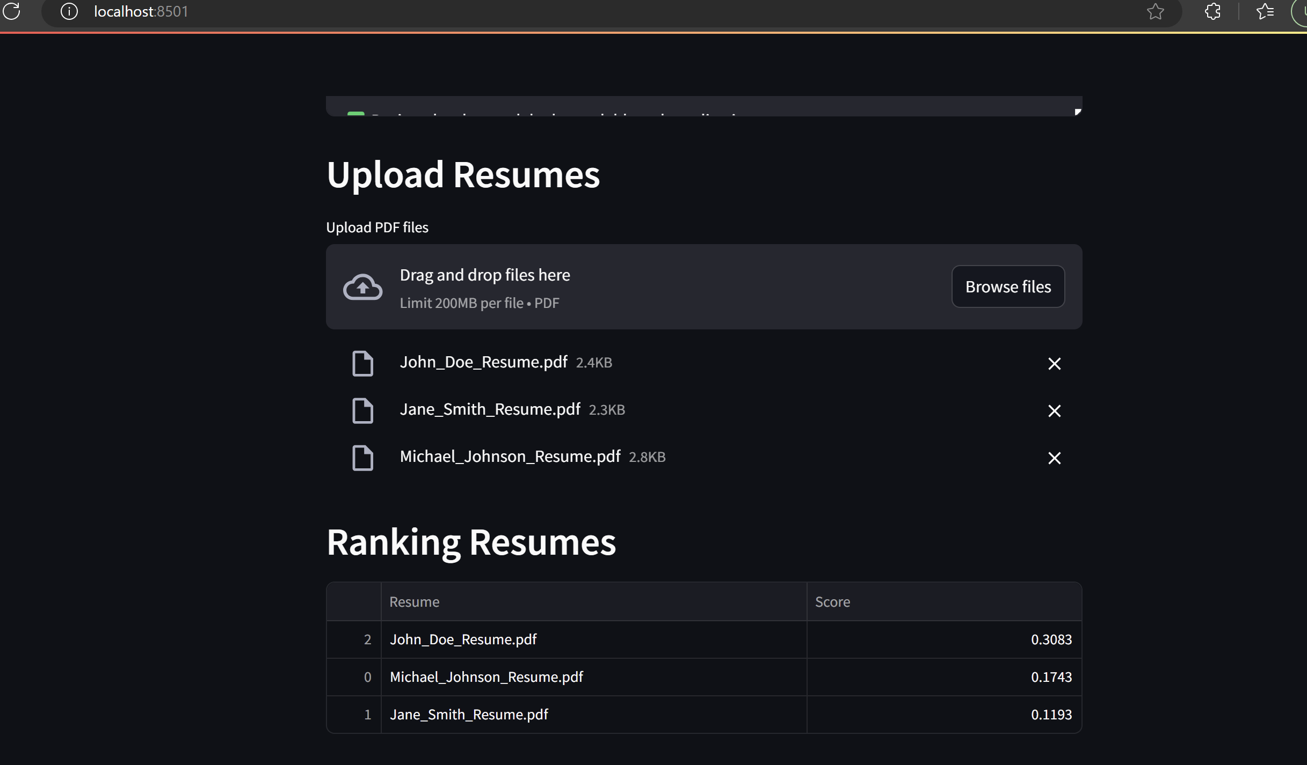
Live Demo of Project

Slide 5
Conclusion
AI-powered resume ranking reduces manual effort and hiring biases.
Enhances recruitment efficiency using NLP and ML techniques.
Demonstrates AI's potential in transforming HR processes.

Slide 6
Future Scope
Integration with ATS (Applicant Tracking Systems).
Improving NLP techniques (BERT, Transformer models).
Incorporating experience, skills, and certifications into ranking.

Slide 7
Thank you!
Notes:
thank you very much for joining this PPT, keep learning.
7

